Slide 1
Ray Marching on GPU
Nicolas Hsu

Slide 2
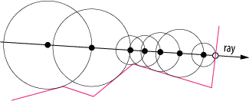
"Sphere Marching" / "Distance-Aided Ray Marching"
https://computergraphics.stackexchange.com/a/163
Notes:
In ray tracing, we compute a bunch of intersection tests.
In ray marching, we compute a bunch of distance functions.
At each step, we ask "what is the distance to the closest possible object?" and move forward by that much.
This ensures you don’t go into walls.

Slide 3
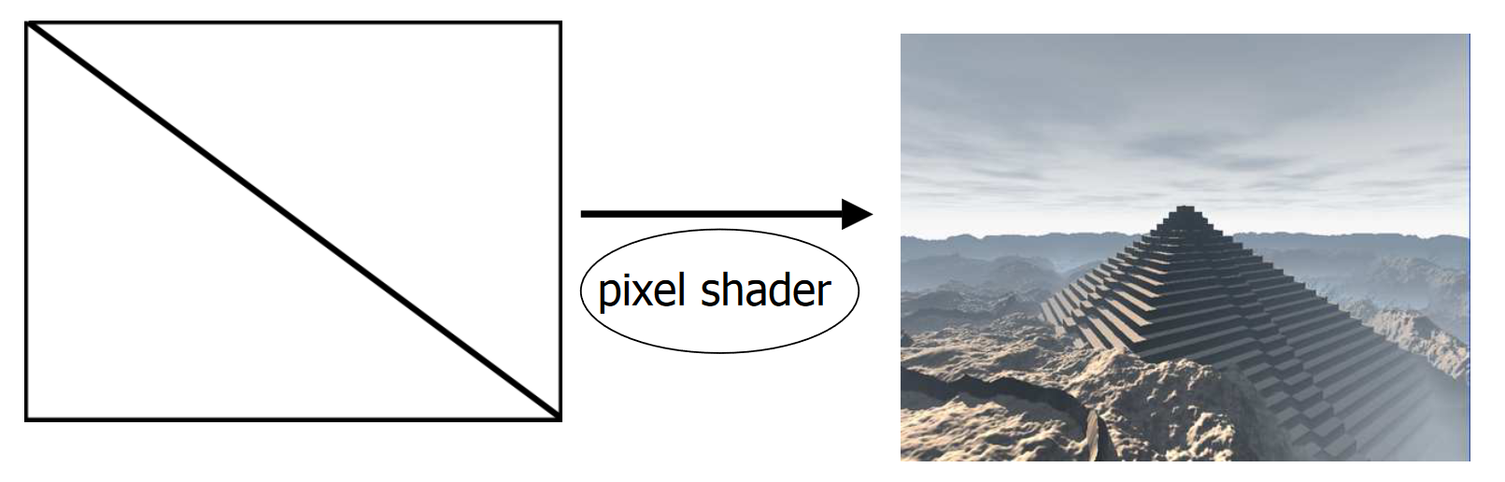
Shader
https://iquilezles.org/articles/nvscene2008/rwwtt.pdf
Notes:
This is coded by making two triangles and shooting rays through every pixel.
All of the marching logic and distance computation is written in shader code.

Slide 4
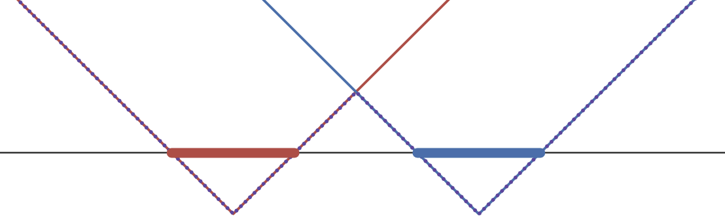
Distance Fields in 1D
Notes:
Suppose these two intervals are your objects.
The red line is how far you are from the red object.
The blue line is how far you are from the blue object.
The purple line is how far you are from any object.
The purple line is the min of the red and blue lines.

Slide 5
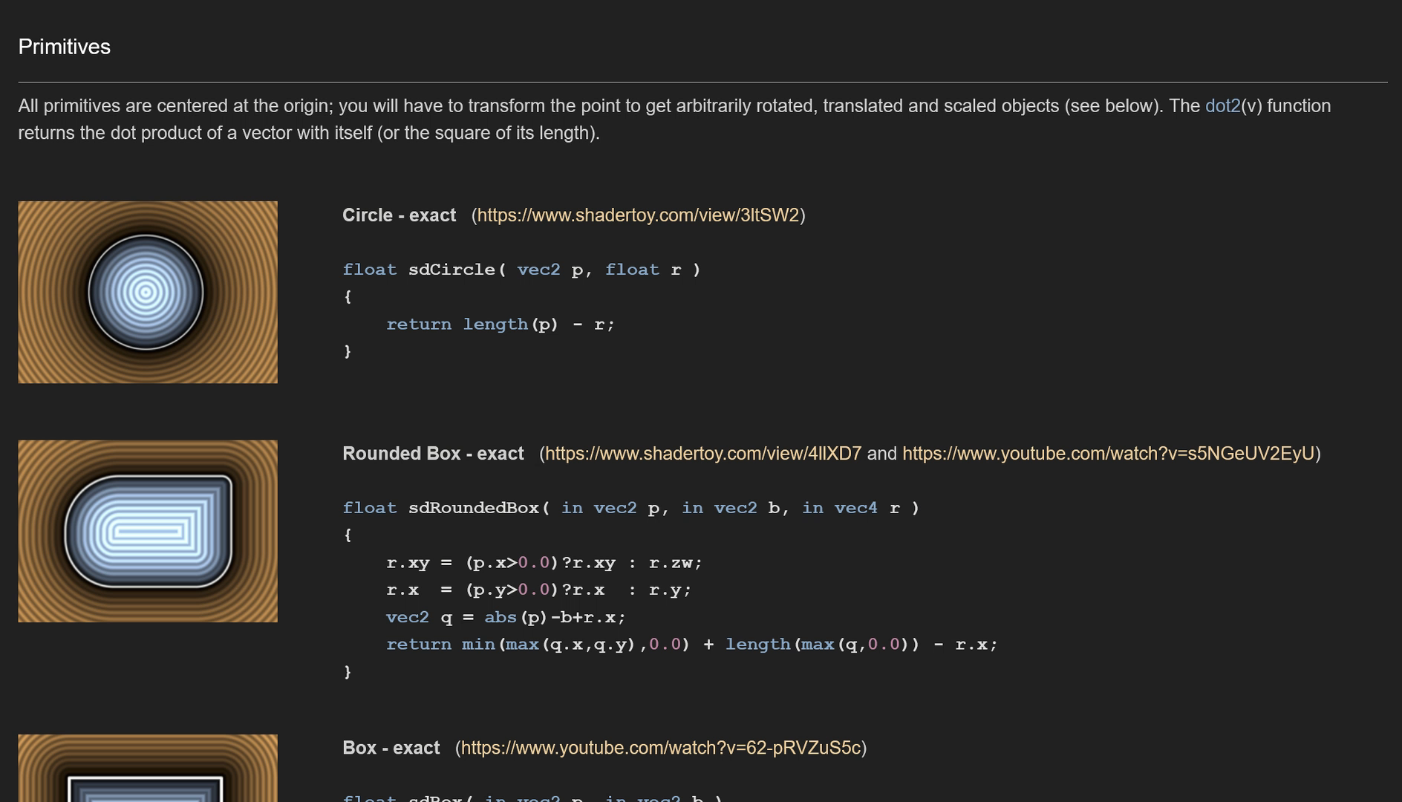
Distance Fields in 2D
https://iquilezles.org/articles/distfunctions2d/
Notes:
Here we see a bunch of distance fields for 2D shapes

Slide 6
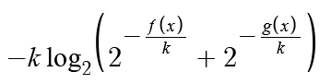
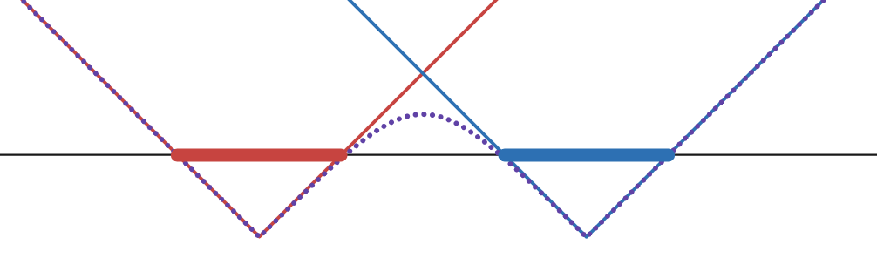
Smoothmin Distance Fields in 1D
Notes:
There are many ways to take smooth minimums, this is one possible function in 1D.

Slide 7
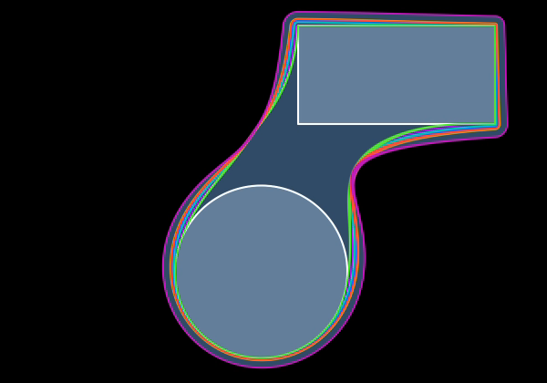
Smooth Distance Fields in 2D
https://iquilezles.org/articles/smin/
Notes:
Here’s smoothing in 2D

Slide 8
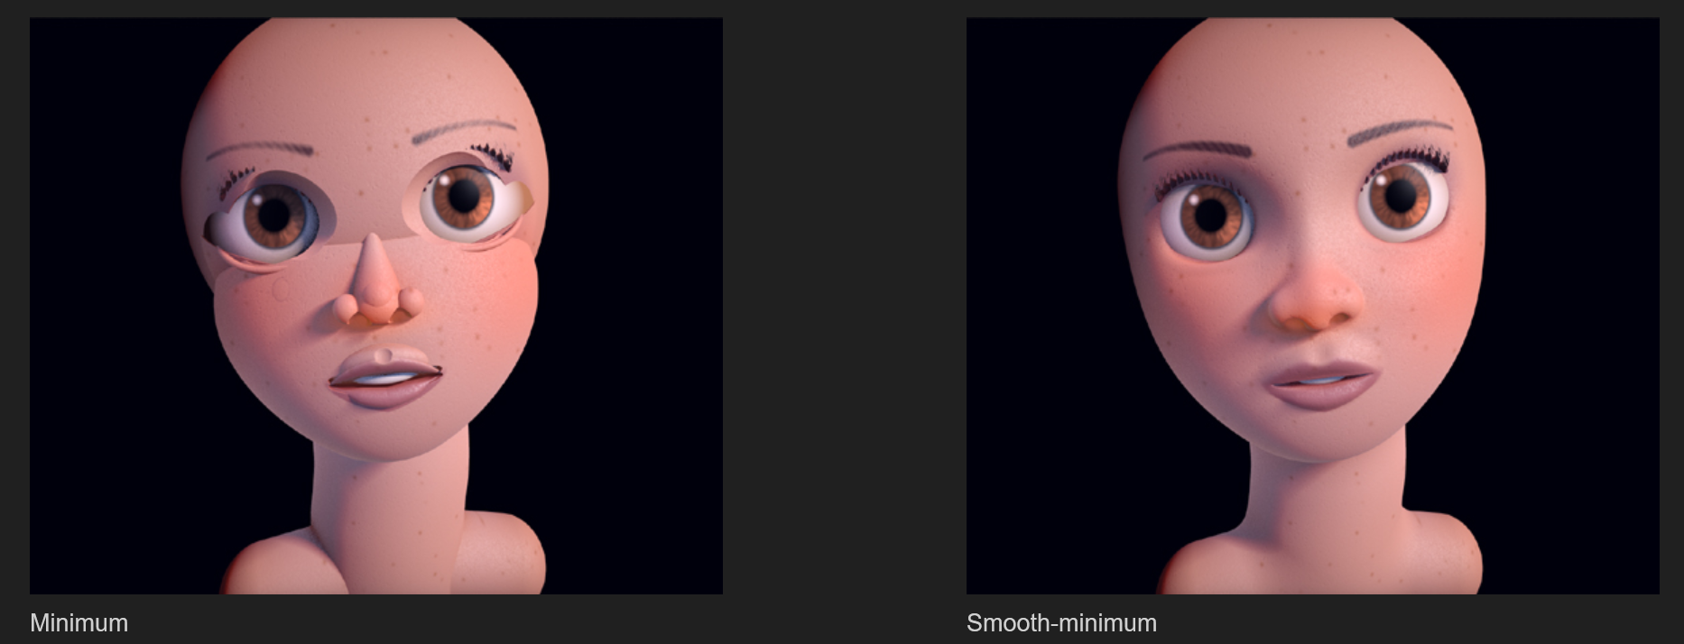
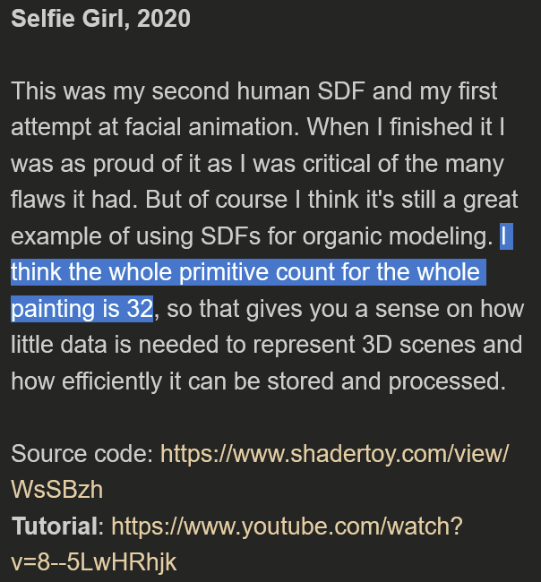

Smooth Face
https://iquilezles.org/articles/raymarchingdf/, https://iquilezles.org/articles/smin/
Notes:
With smooth ray marching, you can use just a little bit of geometry to make scenes that would otherwise take millions of triangles to render.

Slide 9
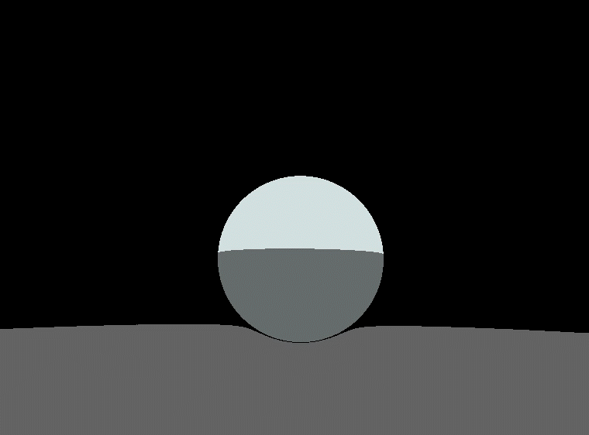
Smooth animation

Slide 10
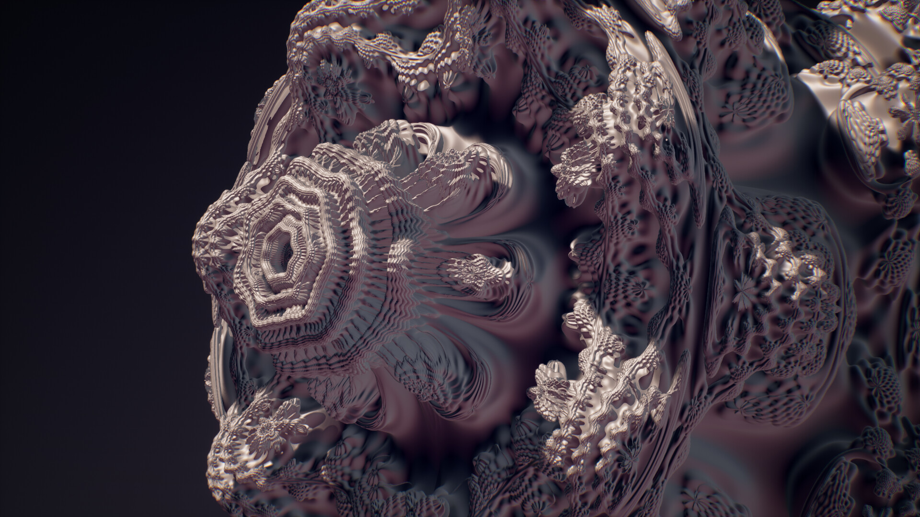
Other cool stuff: fractals
https://lesliestowe.artstation.com/projects/aGgDkk

Slide 11
thanks

